Slide 1
Mobile Computing
Wireless LAN and ATM

Slide 2
Wireless Local Area Network (WLAN)
Restricted in their diameter to buildings, a campus, single rooms etc.
Are operated by individuals
Global goal of WLANs is to
Replace office cabling,
Enable tetherless access to the internet
Introduce a higher flexibility for ad-hoc communication

Slide 3
WLAN
Advantages
Flexibility
Planning
Design
Robustness
Cost
Disadvantages
Quality of service
Proprietary solutions
Restrictions
Safety and security

Slide 4
Infra red vs radio transmission
Two basic transmission technologies
Infra red light (e.g., at 900 nm wavelength),
Radio transmission in the GHz range (e.g., 2.4 GHz in the license-free ISM band).

Slide 5
Infra red
Uses diffuse light reflected at walls, furniture etc. or
Directed light if a line-of-sight (LOS) exists between sender and receiver.
Senders can be
Simple light emitting diodes (LEDs)
Laser diodes.
Photodiodes act as receivers.

Slide 6
Contnd..
Advantages
Simple and extremely cheap senders and receivers
IrDA 1.0
Data rates of up to 115 kbit/s,
IrDA 1.1
Data rates of 1.152 and 4 Mbit/s.
No licenses are needed
Shielding is very simple
Electrical devices do not interfere with infra red transmission.

Slide 7
Contnd..
Disadvantages
low bandwidth compared to other LAN technologies
Limited transfer rates to 115 kbit/s.
IrDA devices are internally connected to a serial port
Quite easily shielded
Cannot penetrate walls or other obstacles.
For good transmission quality and high data rates
LOS, i.e., direct connection, is needed.

Slide 8
Radio Transmission
Uses radio waves
Advantages
the long-term experiences
Can cover larger areas
Can penetrate (thinner) walls, furniture, plants etc.
Additional coverage is gained by reflection.
Radio typically does not need a LOS if the frequencies are not too high.
Offer much higher transmission rates (e.g., 54 Mbit/s)

Slide 9
Contnd..
Disadvantage
Shielding is not so simple
can interfere with other senders, or electrical devices can destroy data transmitted via radio.
Only permitted in certain frequency bands.
Very limited ranges of license-free bands are available worldwide

Slide 10
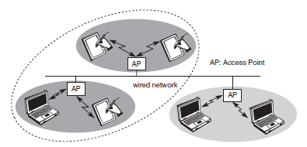
Infrastructure Networks
Infrastructure-based wireless networks
Provide access to other networks, but also include forwarding functions, medium access control etc.
Communication typically takes place only between the wireless nodes and the access point
No direct communication between the wireless nodes.
Eg; IEEE 802.11

Slide 11
Contnd..
The access point
Control medium access,
Acts as a bridge to other wireless or wired networks.
A larger network beyond actual radio coverage can be formed
The access points together with the fixed network in between can connect several wireless networks.

Slide 12
Contnd..
Design of infrastructure-based wireless networks is simpler
Most of the network functionality lies within the access point, whereas the wireless clients can remain quite simple.
Structure is reminiscent of switched Ethernet or other star-based networks
Can use different access schemes with or without collision.
If only the access point controls medium access, no collisions are possible
The access point may poll the single wireless nodes to ensure the data rate.

Slide 13
Contnd..
They cannot be used for disaster relief in cases where no infrastructure is left.
Typical cellular phone networks are infrastructure-based networks for a wide area.
satellite-based cellular phones have an infrastructure.
Infrastructure does not necessarily imply a wired fixed network.

Slide 14
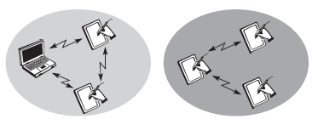
Ad hoc Networks
Do not need any infrastructure to work.
Each node can communicate directly with other nodes,
No access point controlling medium access is necessary.
Nodes can only communicate if they can reach each other physically
Within each other’s radio range or if other nodes can forward the message
Eg; Bluetooth

Slide 15
Contnd..
The complexity of each node is higher
Every node has to implement
Medium access mechanisms,
Mechanisms to handle hidden or exposed terminal problems,
Priority mechanisms,
To provide a certain quality of service.
This type of wireless network exhibits the greatest possible flexibility
For unexpected meetings,
Quick replacements of infrastructure or communication scenarios far away from any infrastructure.

Slide 16
There is no network come in their pure form
There are networks that rely on access points and infrastructure for basic services
That also allow for direct communication between the wireless nodes.
Only selected nodes have the capabilities of forwarding data.
Most of the nodes have to connect to such a special node first to transmit data if the receiver is out of their range.

Slide 17
IEEE 802.11
Wireless standard belongs to the group of 802.x LAN standards.
e.g., 802.3 Ethernet or 802.5 Token Ring.
Offers the same interface as the others to higher layers except physical and medium access layer to maintain interoperability.
Offers time-bounded and asynchronous services.
MAC layer should be able to operate with multiple physical layers.
Candidates for physical layers were
Infra red and spread spectrum radio transmission techniques.

Slide 18
Contnd..
Additional features
The support of power management to save battery power,
The handling of hidden nodes,
The ability to operate worldwide.
The 2.4 GHz ISM band was chosen for the original standard
Data rates
1 Mbit/s mandatory and 2 Mbit/s optional.

Slide 19
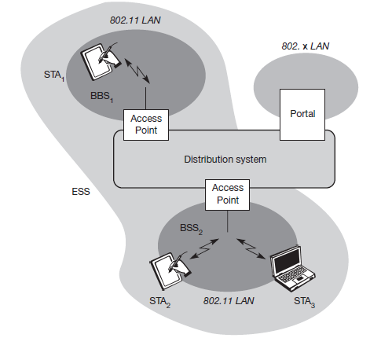
System architecture
Infrastructure-based IEEE 802.11

Slide 20
Contnd..
Stations (STAi): Terminals with access mechanisms to the wireless medium and radio contact to the AP.
Access Points (AP). Several nodes, called stations are connected
Basic Service Set (BSSi). The same radio coverage formed by the stations and the AP.
Distribution System: Several BSSs are connected together via APs.

Slide 21
Contnd..
Extended Service Set (ESS) A distribution system connects several BSSs via the AP to form a single network and thereby extends the wireless coverage area.
ESSID
The ‘name’ of a network
Used to separate different networks.
Without ESSID, it should not be possible to participate in the WLAN.
The distribution system connects the wireless networks via the APs with a portal, which forms the interworking unit to other LANs.

Slide 22
Contnd..
Architecture of the distribution system is not specified
The distribution system consist of
Bridged IEEE LANs,
Wireless links,
Any other networks.
Distribution system services are defined in the standard

Slide 23
Contnd..
Stations can select an AP and associate with it.
The APs support roaming (i.e., changing access points),
The distribution system handles data transfer between the different APs.
APs provide synchronization within a BSS,
Supports power management,
Can control medium access to support time-bounded service.

Slide 24
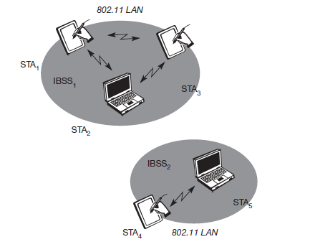
IEEE 802.11
Ad-hoc-based IEEE 802.11

Slide 25
Contnd..
Forming one or more independent BSSs (IBSS)
IBSS comprises a group of stations using the same radio frequency.
Station in an IBSS can communicate with stations only in the same IBSS.
Several IBSSs can either be formed via
The distance between the IBSSs
By using different carrier frequencies
The IBSSs could overlap physically.
IEEE 802.11 does not specify any special nodes that support routing, forwarding of data or exchange of topology information

Slide 26
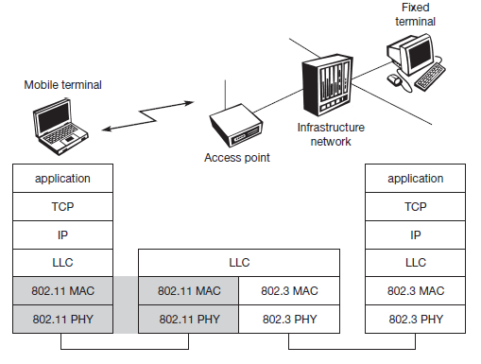
Protocol Architecture

Slide 27
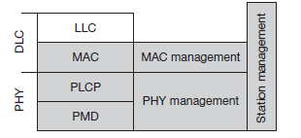
Contnd..
Only covers the physical layer PHY and medium access layer MAC
The physical layer is subdivided into
The physical layer convergence protocol (PLCP)
Provides a carrier sense signal, called clear channel assessment (CCA),
Provides a common PHY service access point (SAP) independent of the transmission technology
The physical medium dependent sublayer (PMD)
Handles modulation and encoding/decoding of signals.
PHY management
The main tasks include channel tuning and PHY MIB maintenance.

Slide 28
Contnd..
MAC
Access mechanisms, fragmentation, encryption
Specifies MAC management layer
Supports the association and re-association of a station to an access point
Roaming between different access points.
Controls authentication mechanisms,
Encryption,
Synchronization of a station with regard to an access point,
Power management to save battery power.
MAC management also maintains the MAC management information base (MIB).

Slide 29
Contnd..
Station management
Interacts with both management layers and is responsible for additional higher layer functions
e.g., control of bridging and interaction with the distribution system in the case of an access point.

Slide 30
Physical Layer
Supports three different physical layers
One layer based on infra red
Two layers based on radio transmission
All PHY variants include the provision of the clear channel assessment signal (CCA).
This is needed for the MAC mechanisms and
Indicates if the medium is currently idle.

Slide 31
Frequency Hopping Spread Spectrum (FHSS)
Allows for the coexistence of multiple networks in the same area
By separating different networks using different hopping sequences.
Defines 79 hopping channels for North America and Europe, and 23 hopping channels for Japan.
The selection of a particular channel is achieved by using a pseudo-random hopping pattern.
Specifies Gaussian shaped FSK as modulation.
The maximum transmit power is 1 W in the US, 100 mW EIRP in Europe and 10 mW/MHz in Japan.

Slide 32

FHSS PHY - Frame Structure
Consists of two basic parts,
The PLCP part (preamble and header)
Always transmitted at 1 Mbit/s
The payload part (MAC data).
Can use 1 or 2 Mbit/s
Scrambled using the polynomial s(z) = z⁷ + z⁴ + 1
For DC blocking and whitening of the spectrum.

Slide 33
Contnd..
Synchronization:
The PLCP preamble starts with 80 bit synchronization, which is a 010101... bit pattern. This pattern is used for synchronization of potential receivers and signal detection by the CCA.
Start frame delimiter (SFD):
The following 16 bits indicate the start of the frame and provide frame synchronization. The SFD pattern is 0000110010111101.
PLCP_PDU length word (PLW):
This first field of the PLCP header indicates the length of the payload in bytes including the 32 bit CRC at the end of the payload. PLW can range between 0 and 4,095.
PLCP signalling field (PSF):
This 4 bit field indicates the data rate of the payload following. All bits set to zero (0000) indicates the lowest data rate of 1 Mbit/s. The granularity is 500 kbit/s, thus 2 Mbit/s is indicated by 0010 and the maximum is 8.5 Mbit/s (1111). This system obviously does not accommodate today’s higher data rates.
Header error check (HEC):
Finally, the PLCP header is protected by a 16 bit checksum with the standard ITU-T generator polynomial G(x) = x¹⁶ + x¹² + x⁵ + 1.

Slide 34
Direct sequence spread spectrum (DSS)
Alternative spread spectrum method separating by code and not by frequency.
spreading is achieved using the 11-chip Barker sequence (+1, –1, +1, +1, –1, +1, +1, +1, –1
The key characteristics
It is robust against interference
It is insensitive to multipath propagation (time delay spread).
The implementation is more complex than FHSS.

Slide 35
Modulation schemes
Differential binary phase shift keying (DBPSK) for 1 Mbit/s transmission
Differential quadrature phase shift keying (DQPSK) for 2 Mbit/s
The maximum transmit power is 1 W in the US, 100 mW EIRP in Europe and 10 mW/MHz in Japan.
The symbol rate is 1 MHz, resulting in a chipping rate of 11 MHz.
All bits are Scrambled using the polynomial s(z) = z⁷ + z⁴ + 1
For DC blocking and whitening of the spectrum.

Slide 36

DSS PHY - Frame Structure
Synchronization:
The first 128 bits are not only used for synchronization, but also gain setting, energy detection (for the CCA), and frequency offset compensation. The synchronization field only consists of scrambled 1 bits.
Start frame delimiter (SFD):
This 16 bit field is used for synchronization at the beginning of a frame and consists of the pattern 1111001110100000.

Slide 37
DSS PHY - Frame Structure
Signal:
Originally, only two values have been defined for this field to indicate the data rate of the payload. The value 0x0A indicates 1 Mbit/s (and thus DBPSK), 0x14 indicates 2 Mbit/s (and thus DQPSK). Other values have been reserved for future use, i.e., higher bit rates. Coding for higher data rates is explained in sections 7.3.6 and 7.3.7.
Service:
This field is reserved for future use; however, 0x00 indicates an IEEE 802.11 compliant frame.
Length:
16 bits are used in this case for length indication of the payload in microseconds.
Header error check (HEC):
Signal, service, and length fields are protected by this checksum using the ITU-T CRC-16 standard polynomial.

Slide 38
Infra red
Uses near visible light at 850–950 nm.
Does not require a line-of-sight between sender and receiver, but should also work with diffuse light.
Allows for point-to-multipoint communication.
Maximum range is about 10 m
If no sunlight or heat sources interfere with the transmission
only work in buildings
Frequency reuse is very simple
A wall is more than enough to shield one IR based IEEE 802.11 network from another.
Proprietary products offer, e.g., up to 4 Mbit/s using diffuse infra red light.
Alternatively, directed infra red communication based on IrDA can be used.

Slide 39
Medium Access Control Layer
Control medium access, offer support for roaming, authentication, and power conservation.
Provided Traffic Services in;
Ad-hoc N/W
Mandatory asynchronous data service
Infrastructure – based N/W
Mandatory asynchronous data service and an optional time-bounded service.

Slide 40
Contnd..
Basic access mechanisms
Distributed coordination function (DCF),
The mandatory basic method based on a version of CSMA/CA, & An optional method avoiding the hidden terminal problem, and
Offers only asynchronous service
Point coordination function (PCF).
A contention- free polling method for time-bounded service.
offers both asynchronous and time-bounded service
Requires an access point that controls medium access and polls the single nodes
Also Known as distributed foundation wireless medium access control (DFWMAC)

Slide 41
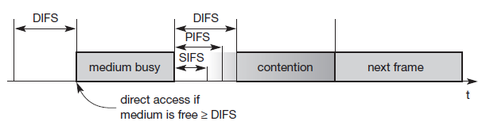
Priorities of Medium Access
Short inter-frame spacing (SIFS)
The shortest waiting time for medium access (so the highest priority)
Defined for short control messages,
Such as acknowledgements of data packets or polling responses.
For DSSS SIFS is 10 μs and for FHSS it is 28 μs.

Slide 42
Contnd..
PCF inter-frame spacing (PIFS)
A waiting time between DIFS and SIFS (and thus a medium priority)
Used for a time-bounded service.
An access point polling other nodes only has to wait PIFS for medium access.
PIFS is defined as SIFS plus one slot time.
DCF inter-frame spacing (DIFS)
This parameter denotes the longest waiting time and has the lowest priority for medium access.
This waiting time is used for asynchronous data service within a contention period.
DIFS is defined as SIFS plus two slot times.

Slide 43
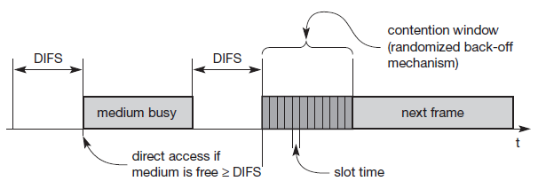
Basic DFWMAC-DCF using CSMA/CA
a random access scheme with carrier sense and collision avoidance through random backoff.
Notes:
carrier sense multiple access with collision avoidance (CSMA/CA),

Slide 44
Contnd..
If the medium is busy, nodes have to wait for the duration of DIFS, entering a contention phase afterwards.
Each node now chooses a random backoff time within a contention window and delays medium access for this random amount of time.
The node continues to sense the medium.
As soon as a node senses the channel is busy, it has lost this cycle and has to wait for the next chance,
i.e., until the medium is idle again for at least DIFS.

Slide 45
Contnd..
But if the randomized additional waiting time for a node is over and the medium is still idle, the node can access the medium.
The additional waiting time is measured in multiples of the above-mentioned slots.
This additional randomly distributed delay helps to avoid collisions – otherwise all stations would try to transmit data after waiting for the medium becoming idle again plus DIFS.
Backoff timer with boe (the elapsed backoff time) and bor (the residual backoff time) improves the fairness

Slide 46
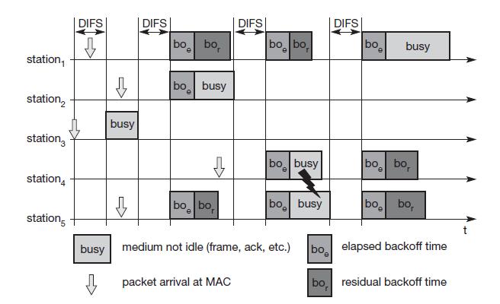

Slide 47
Depending on the size of the contention window (CW), the random values can
either be too close together (causing too many collisions)
or the values are too high (causing unnecessary delay).
CWmin = 7 & CWmax = 255

Slide 48
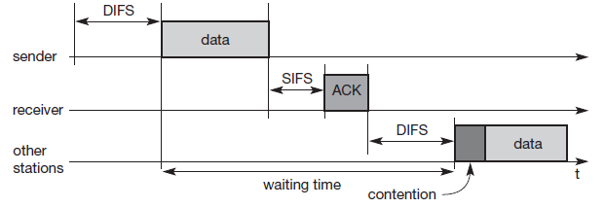
Access Mechanism Unicast
Receiver answers directly with an acknowledgement (ACK).
Waiting for a duration of SIFS
No other station can access the medium
If no ACK; limited retransmission
No special rules for retransmissions
Sender has to wait again

Slide 49
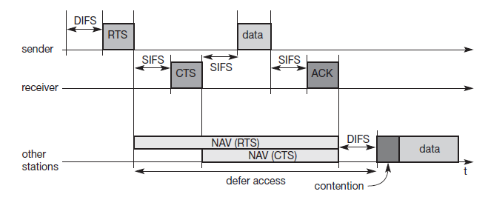
DFWMAC-DCF with RTS/CTS extension
Problem of hidden terminals
If one station can receive two others, but those stations cannot receive each other.
Soln using two control packets, RTS and CTS
Mechanism is optional

Slide 50
Contnd..
This mechanism reserves the medium for one sender exclusively
After waiting for DIFS , the sender can issue a request to send (RTS) control packet.
RTS packet includes the receiver of the data transmission to come and the duration of the whole data transmission.
Every node receiving this RTS now has to set its net allocation vector (NAV) in accordance with the duration field.
The NAV then specifies the earliest point at which the station can try to access the medium again.

Slide 51
Contnd..
On receiving RTS, the receiver answers with a clear to send (CTS) message after waiting for SIFS.
All stations receiving CTS packet from the receiver have to adjust their NAV.
Now all nodes within receiving distance around sender and receiver are informed.
Finally, the sender can send the data after SIFS.
Acknowledgement triggered after SIFS.
The NAV in each node marks the medium as free and the standard cycle can start again

Slide 52
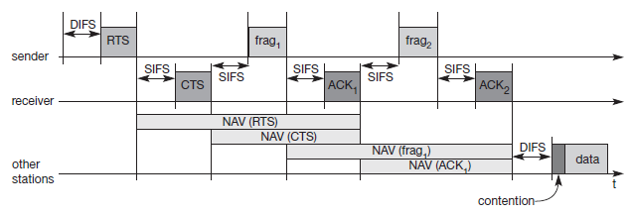
Contnd..
Adopts fragmenting a user data packet to decrease the bit error rate

Slide 53
DFWMAC-PCF with Polling
Requires an access point that controls medium access and polls the single nodes.
The point co-ordinator in the access point splits the access time into super frame periods
A super frame comprises a contention free period and a contention period.
The contention period can be used for the two access mechanisms presented above.
The start of the super frame may be postponed.

Slide 54
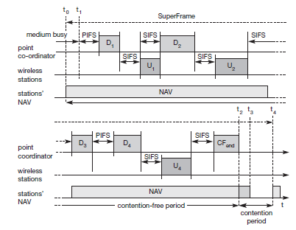

Slide 55
Contnd..
The point coordinator now sends data D1 downstream to the first wireless station.
This station can answer at once after SIFS
After waiting for SIFS again, the point coordinator can poll the second station by sending D2.
This station may answer upstream to the coordinator with data U2.
Polling continues with the third node.
This time the node has nothing to answer and the point coordinator will not receive a packet after SIFS.
After waiting for PIFS, the coordinator can resume polling the stations.
Finally, the point coordinator can issue an end marker (CFend), indicating that the contention period may start again.

Slide 56
Contnd..
The transmission properties of the whole wireless network are determined by the polling behavior of the access point.
If only PCF is used and polling is distributed evenly, the bandwidth is also distributed evenly among all polled nodes.
This would resemble a static, centrally controlled time division multiple access (TDMA) system with time division duplex (TDD) transmission.
This method comes with an overhead if nodes have nothing to send, but the access point polls them permanently.

Slide 57
Contnd..
Using PCF automatically sets the NAV, preventing other stations from sending.
The contention-free period planned initially would have been from t0 to t3.
However, the point coordinator finished polling earlier, shifting the end of the contention-free period to t2. At t4, the cycle starts again with the next super frame.

Slide 58
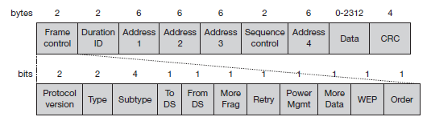
MAC frames

Slide 59
Contnd..
Frame control: The first 2 bytes serve several purposes.
Protocol version: This 2 bit field indicates the current protocol version and is fixed to 0 by now. If major revisions to the standard make it incompatible with the current version, this value will be increased.
Type: The type field determines the function of a frame: management (=00), control (=01), or data (=10). The value 11 is reserved. Each type has several subtypes as indicated in the following field.
Subtype: Example subtypes for management frames are: 0000 for association request, 1000 for beacon. RTS is a control frame with subtype 1011, CTS is coded as 1100. User data is transmitted as data frame with subtype 0000.
More fragments: This field is set to 1 in all data or management frames that have another fragment of the current MSDU to follow.

Slide 60
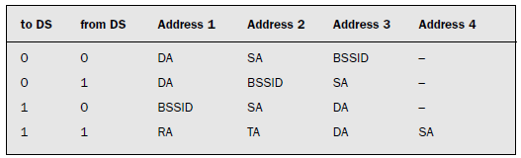
Contnd..
To DS/From DS
Exchanged between two wireless nodes without a distribution system.
Physically originates from an access point.
A station sends a packet to another station via the access point
Packets transmitted between two access points

Slide 61
Contnd..
Retry: If the current frame is a retransmission of an earlier frame, this bit is set to 1. With the help of this bit it may be simpler for receivers to eliminateduplicate frames.
Power management: This field indicates the mode of a station after successful transmission of a frame. Set to 1 the field indicates that the station goes into power-save mode. If the field is set to 0, the station stays active.
More data: In general, this field is used to indicate a receiver that a sender has more data to send than the current frame. This can be used by an access point to indicate to a station in power-save mode that more packets are buffered. Or it can be used by a station to indicate to an access point after being polled that more polling is necessary as the station has more data ready to transmit.
Wired equivalent privacy (WEP): This field indicates that the standard security mechanism of 802.11 is applied. However, due to many weaknesses found in the WEP algorithm higher layer security should be used to secure an 802.11 network (Borisov, 2001).
Order: If this bit is set to 1 the received frames must be processed in strict order.

Slide 62
Contnd..
Duration/ID: If the field value is less than 32,768, the duration field contains the value indicating the period of time in which the medium is occupied (in μs). This field is used for setting the NAV for the virtual reservation mechanism using RTS/CTS and during fragmentation. Certain values above 32,768 are reserved for identifiers.
Address 1 to 4: The four address fields contain standard IEEE 802 MAC addresses (48 bit each), as they are known from other 802.x LANs. The meaning of each address depends on the DS bits in the frame control field and is explained in more detail in a separate paragraph.
Sequence control: Due to the acknowledgement mechanism frames may be duplicated. Therefore a sequence number is used to filter duplicates.
Data: The MAC frame may contain arbitrary data (max. 2,312 byte), which is transferred transparently from a sender to the receiver(s).
Checksum (CRC): Finally, a 32 bit checksum is used to protect the frame as it is common practice in all 802.x networks.

